Slide 1

Weather Forecasting Web Application
A Full Stack Project using Python, Django & Weather API

Slide 2
Introduction
Weather Forecast Web Application is a dynamic web-based system
Provides real-time and forecast weather data
Built using Python and Django framework
Uses external Weather API for live data

Slide 3
Problem Statement
Why this app?
• Weather info scattered across platforms
• Users need fast & accurate updates
• Complex interfaces confuse users
• Need a clean and simple solution

Slide 4
Project Objectives:
Fetches real-time weather using API
Display city-wise temperature an conditions
Show humidity, wind speed and visibility
Provide clean and user-friendly UI

Slide 5
Technology Stack
Frontend
• HTML
• CSS
• JavaScript
• Responsive UI
Backend
• Django (Python)
API
• OpenWeatherMap API
Tools
• VS Code
• Browser

Slide 6
Application Workflow
Flow
• User enters city name
• Request sent to backend
• API fetches live data
• Processed results shown on UI

Slide 7
Key Features
Weather App Highlights
• Real-time weather updates
• Temperature, humidity, wind speed
• Weather condition icons
• User-friendly design

Slide 8
Error Handling
Invalid city name handling
API failure handling
User-friendly error messages

Slide 9
Challenges Faced
During Development
• API integration & errors
• Backend–Frontend connection
• UI responsiveness
• Handling invalid inputs

Slide 10
Advantages of the System
Easy to use
Real-time data
Scalable architecture
Good learning project

Slide 11
Limitations:
Internet Dependency
API requests limits
Accuracy depends on API provider

Slide 12
Results:

Slide 13
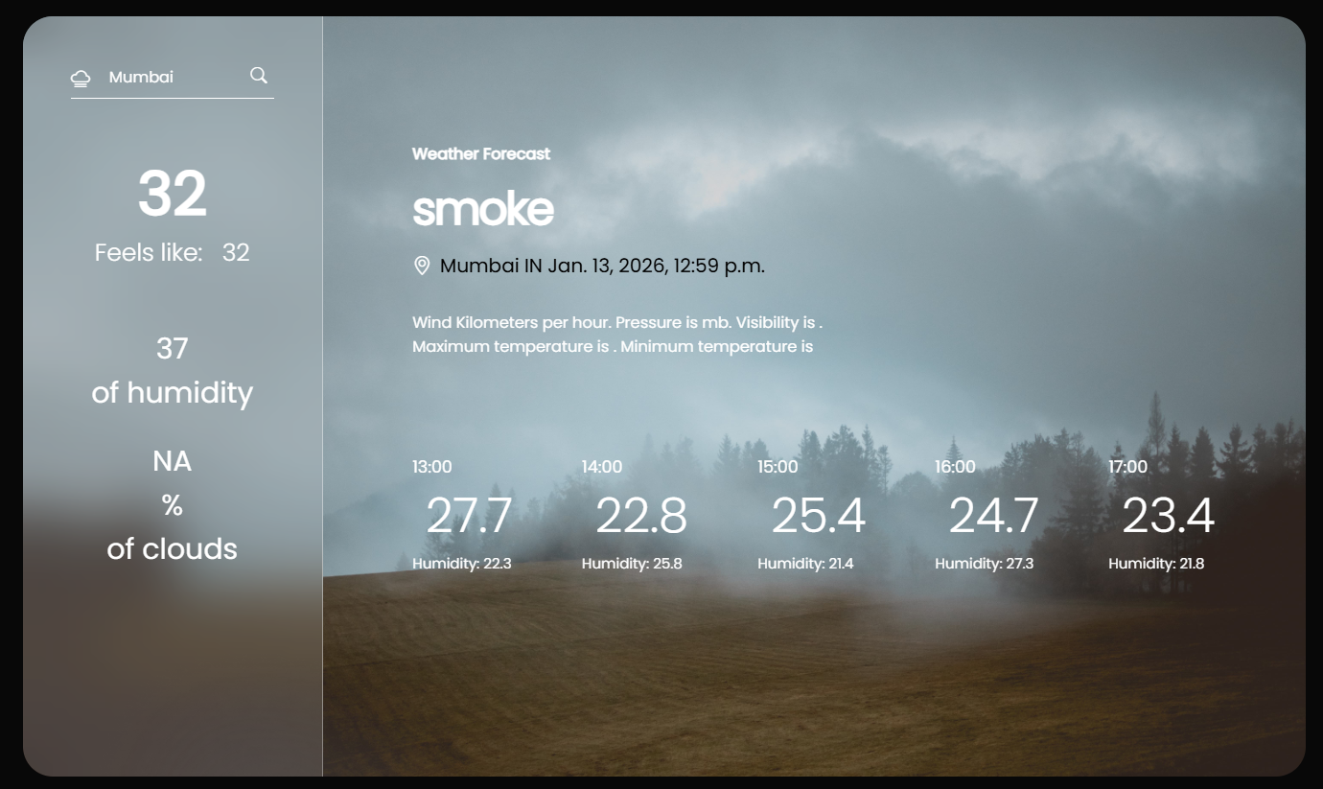
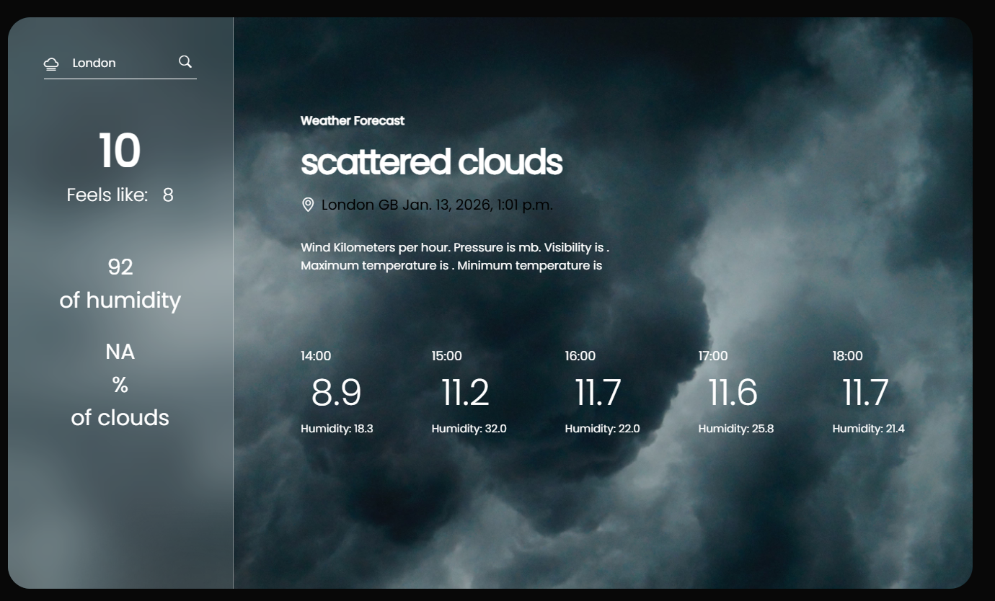
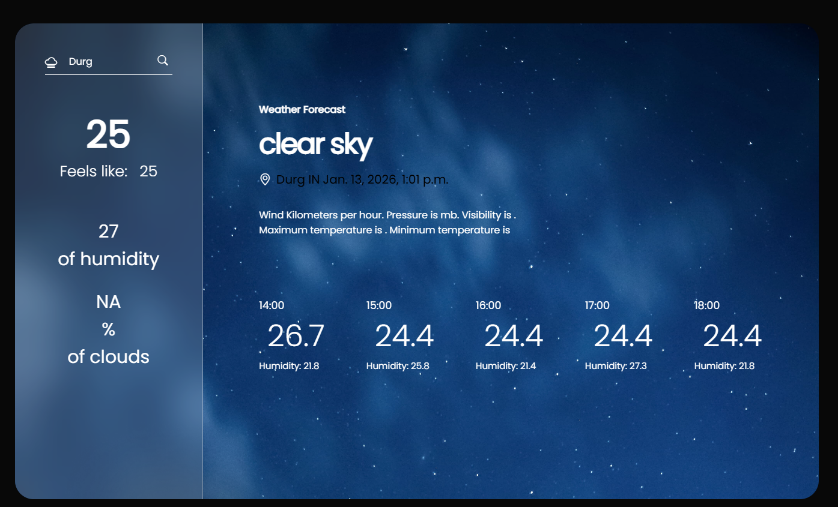
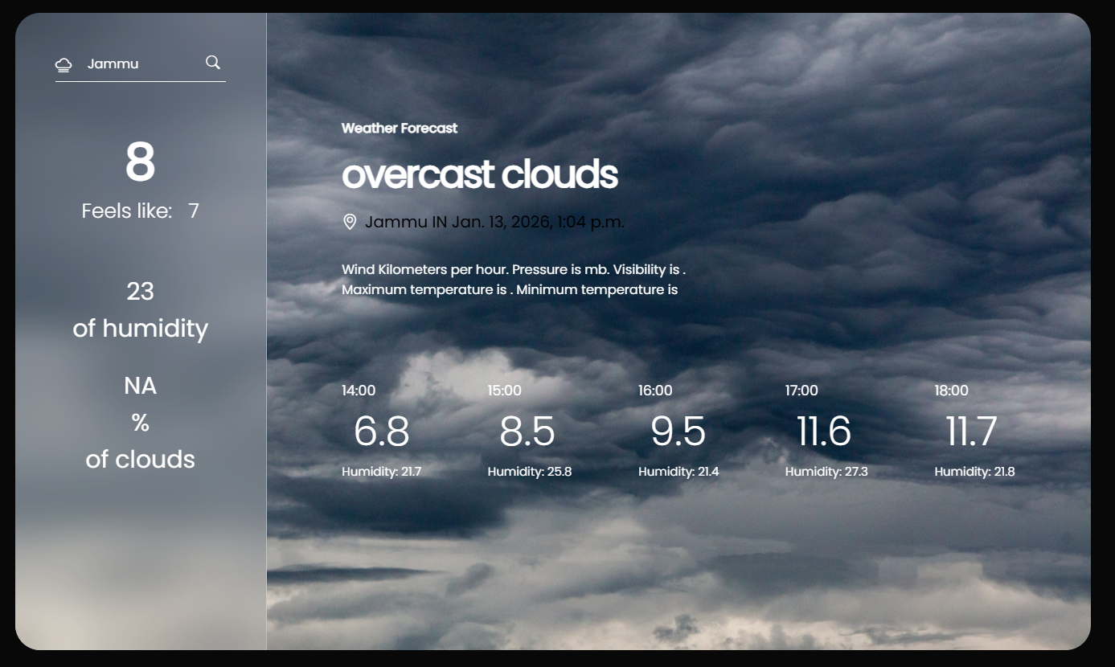

Slide 14
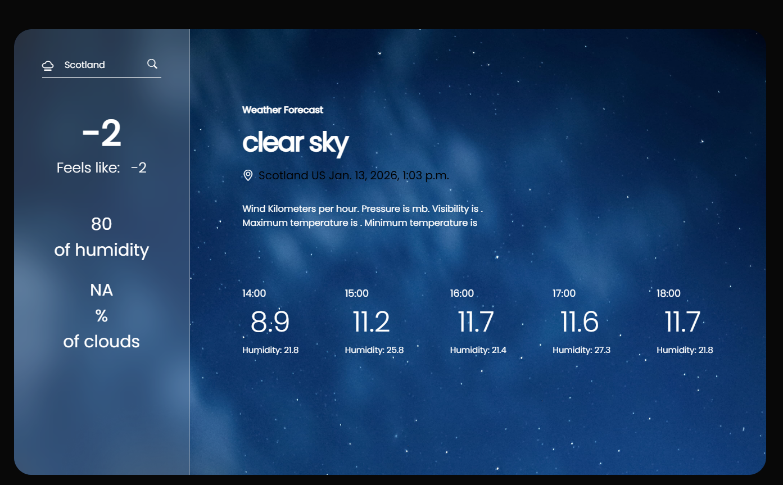
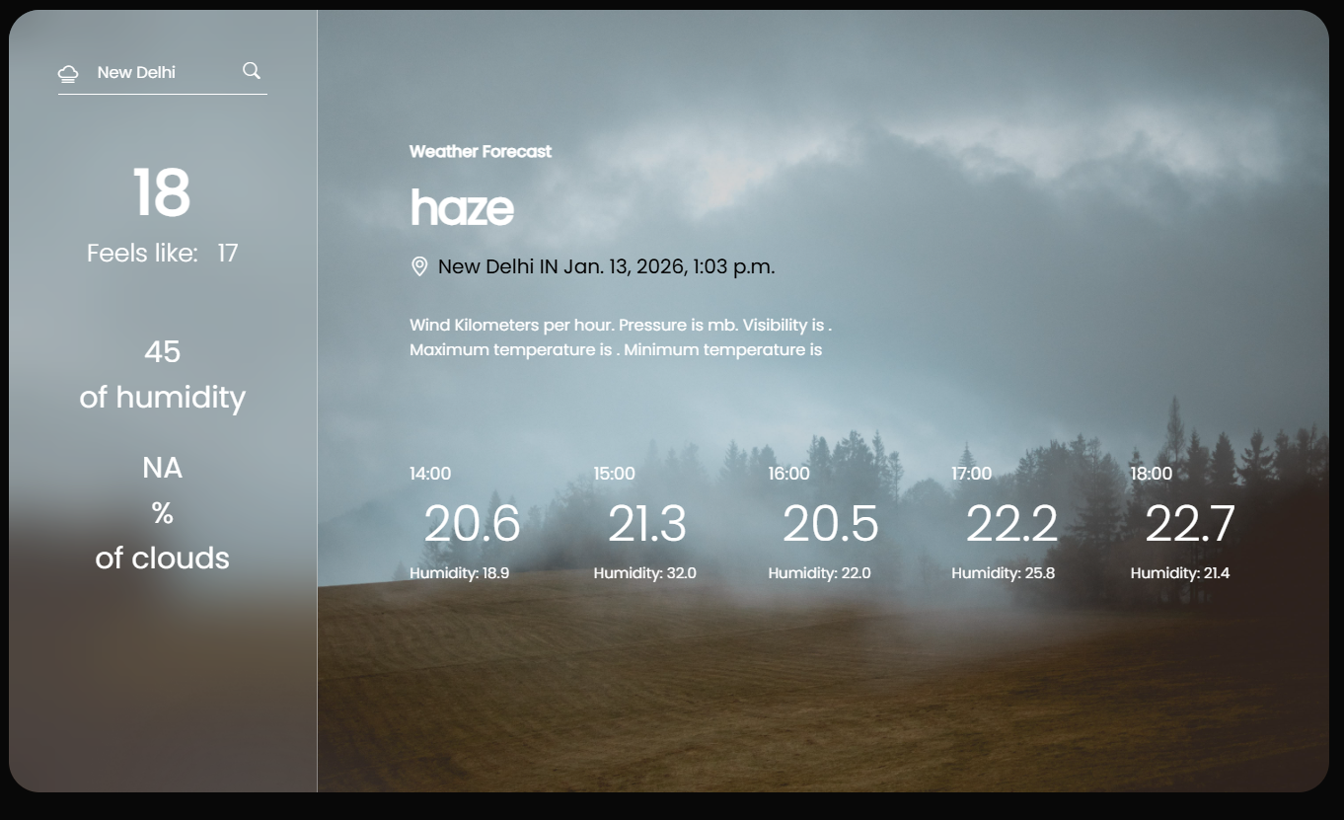
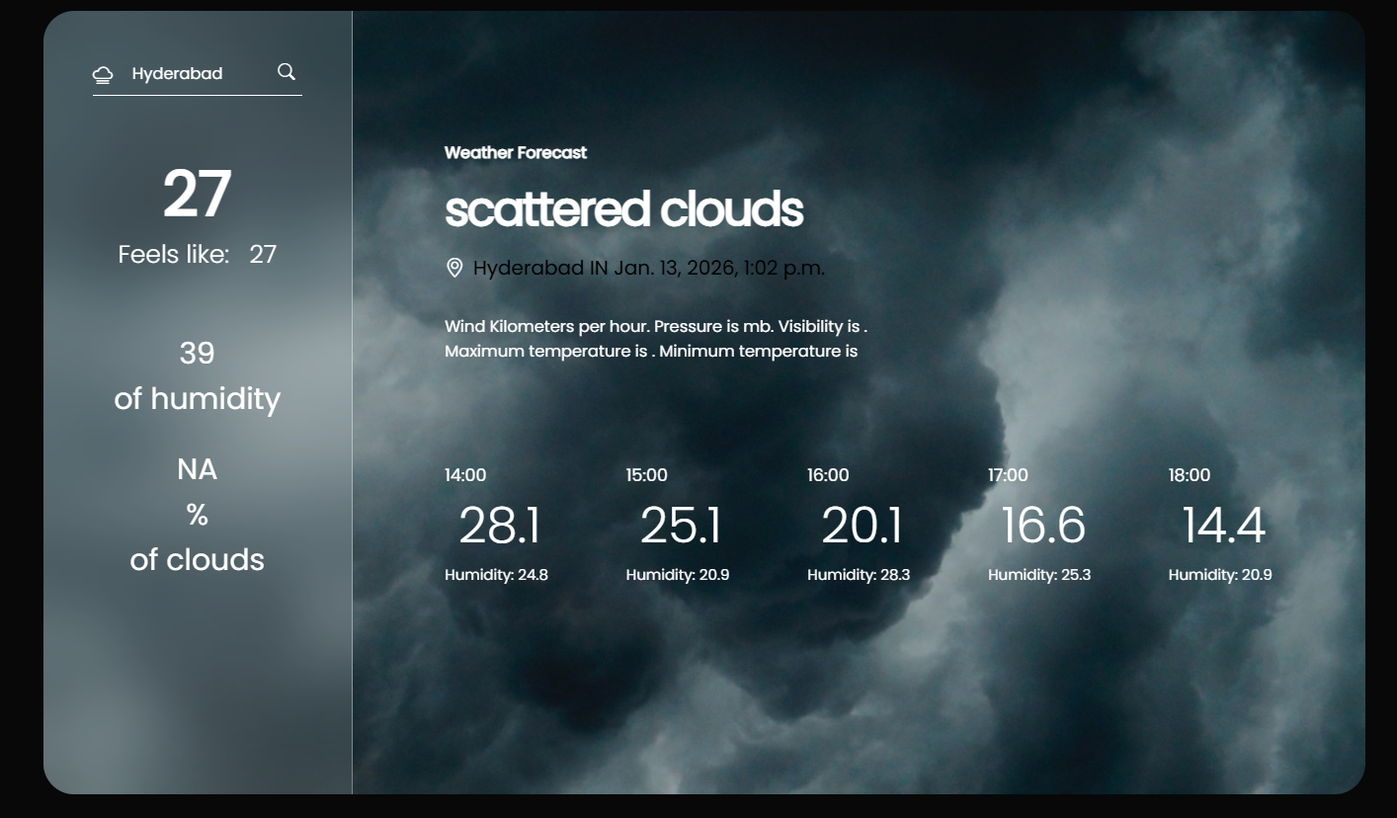
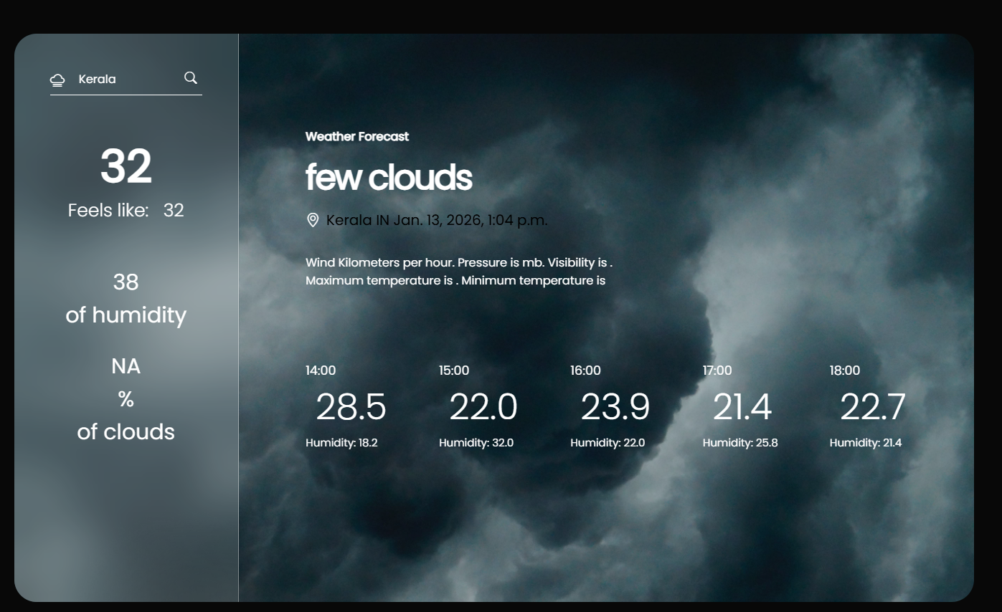

Slide 15
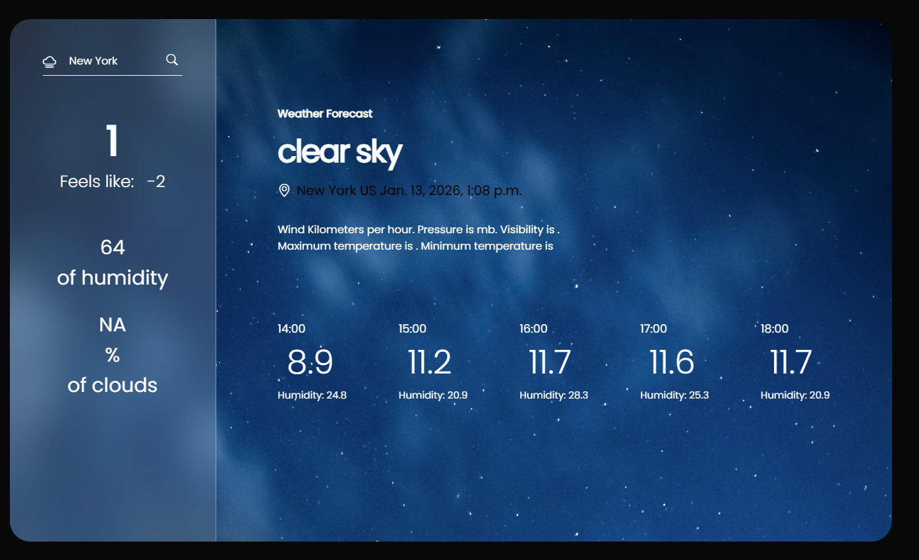
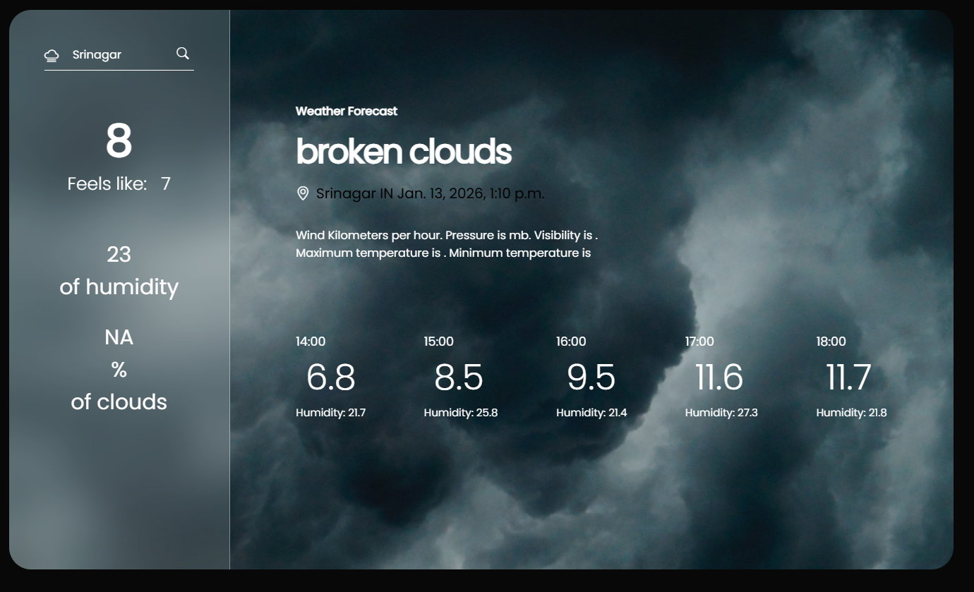
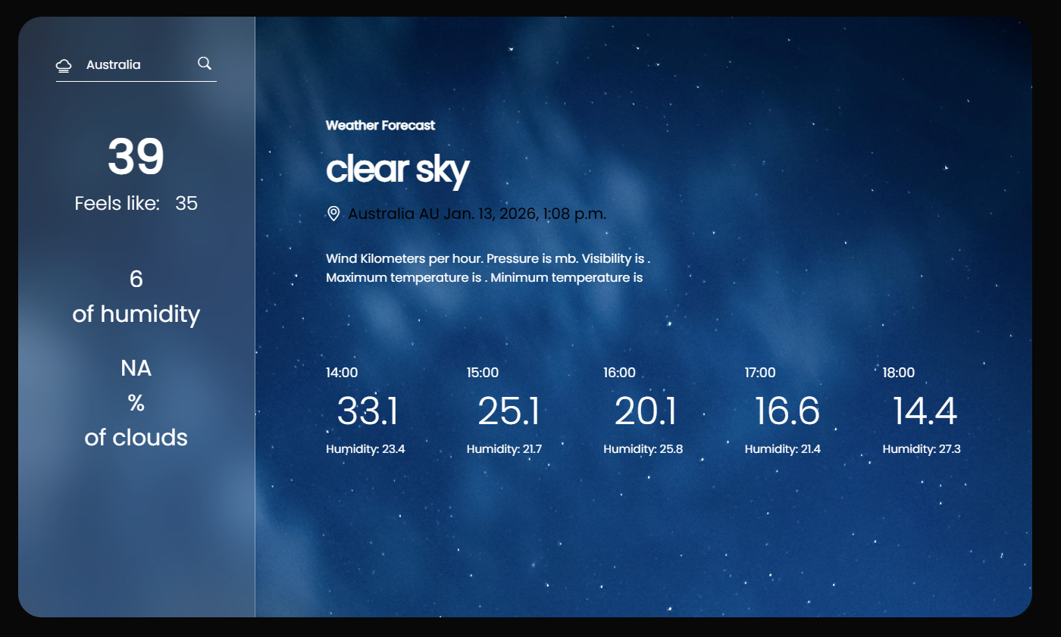
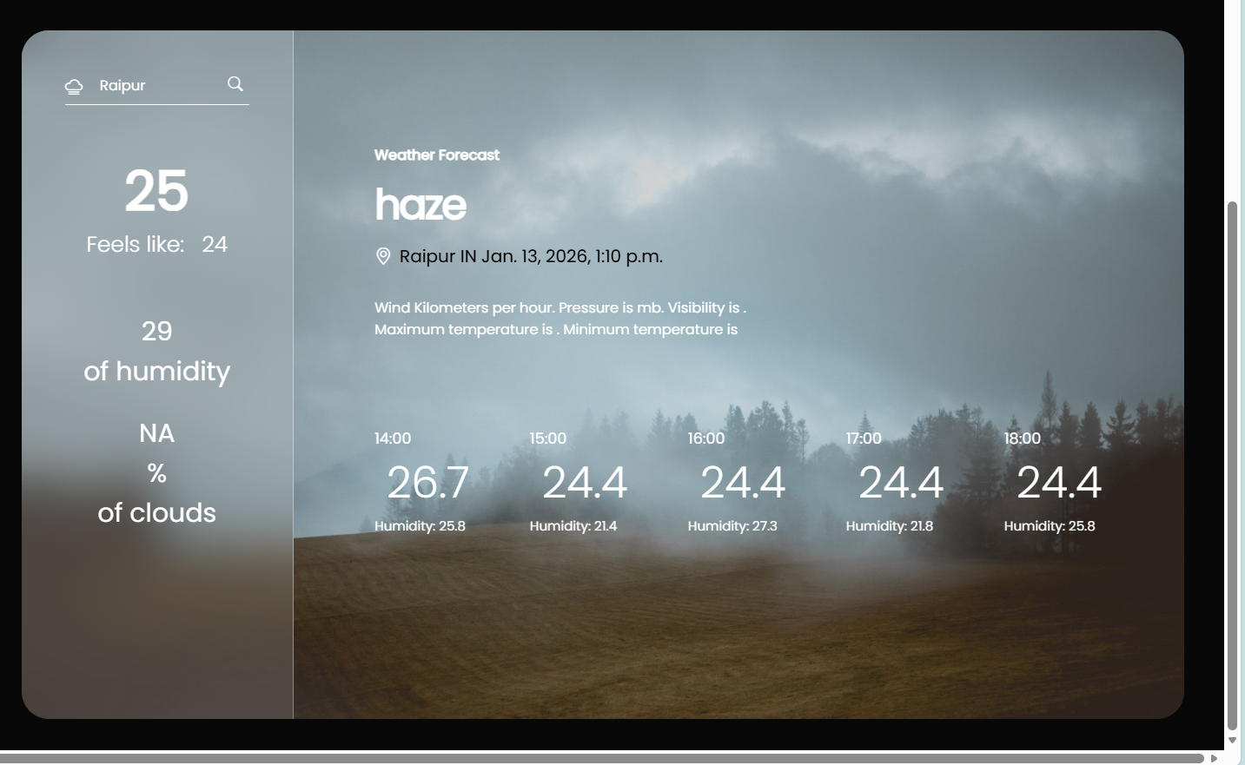

Slide 16
Conclusion & Future Scope
Final Thoughts
• Successfully built a weather app
• Accurate and real-time data
• Future: Forecasts, alerts, maps
• Mobile & GPS integration

Slide 17
Thankyou!

